Slide 1
Data Warehousing
Data
  Raw piece of information that is capable of being moved and store.
Database
  An organized collection of such data in which data are managed in tabular form with relationship.
Data Warehouse
  System that organizes all the data available in an organization, makes it accessible & usable for the all kinds of data analysis and also allows to create a lots of reports by the use of mining tools.
CH#2, Data Warehousing
By: Babu Ram Dawadi

Slide 2
Data Warehouse…
  “A data warehouse is a subject-oriented, integrated, time-variant, and nonvolatile collection of data in support of management’s decision-making process.”
Data warehousing:
  The process of constructing and using data warehouses.
  Is the process of extracting & transferring operational data into informational data & loading it into a central data store (warehouse)
CH#2, Data Warehousing
By: Babu Ram Dawadi

Slide 3
Data Warehouse—Integrated
Constructed by integrating multiple, heterogeneous data sources
  relational databases, flat files, on-line transaction records
Data cleaning and data integration techniques are applied.
  Ensure consistency in naming conventions, encoding structures, attribute measures, etc. among different data sources
    E.g., Hotel price: currency, tax, breakfast covered, etc.
  When data is moved to the warehouse, it is converted.
Sales
system
Payroll
system
Customer
data
Purchasing
system
CH#2, Data Warehousing
By: Babu Ram Dawadi

Slide 4
Data Warehouse—Subject-Oriented
Organized around major subjects, such as customer, product, sales.
Focusing on the modeling and analysis of data for decision makers, not on daily operations or transaction processing.
Provide a simple and concise view around particular subject issues by excluding data that are not useful in the decision support process.
Sales
system
Employee
data
Payroll
system
Customer
data
Vendor
data
Purchasing
system
Operational data DW
CH#2, Data Warehousing
By: Babu Ram Dawadi

Slide 5
Data Warehouse—Time Variant
The time horizon for the data warehouse is significantly longer than that of operational systems.
  Operational database: current value data.
  Data warehouse data: provide information from a historical perspective (e.g., past 5-10 years)
Every key structure in the data warehouse
  Contains an element of time, explicitly or implicitly
  But the key of operational data may or may not contain “time element”.
CH#2, Data Warehousing
By: Babu Ram Dawadi

Slide 6
Data Warehouse—Non-Volatile
A physically separate store of data transformed from the operational environment.
Operational update of data does not occur in the data warehouse environment.
  Does not require transaction processing, recovery, and concurrency control mechanisms
  Requires only two operations in data accessing:
    initial loading of data and access of data.
DBMS
DW
create
access
update
Sales
system
Customer
data
delete
insert
load
CH#2, Data Warehousing
By: Babu Ram Dawadi

Slide 7
Data Warehouse Usage
Three kinds of data warehouse applications
  Information processing
    supports querying, basic statistical analysis, and reporting using crosstabs, tables, charts and graphs
  Analytical processing
    multidimensional analysis of data warehouse data
    supports basic OLAP operations, slice-dice, drilling, pivoting
  Data mining
    knowledge discovery from hidden patterns
    supports associations, constructing analytical models, performing classification and prediction, and presenting the mining results using visualization tools.
CH#2, Data Warehousing
By: Babu Ram Dawadi

Slide 8
The Warehousing Approach
Information integrated in advance
Stored in WH for direct querying and analysis
Clients
Data
Warehouse
Integration System
Metadata
. . .
Extractor/
Monitor
Extractor/
Monitor
Extractor/
Monitor
. . .
Source
Source
Source
CH#2, Data Warehousing
By: Babu Ram Dawadi

Slide 9
General Architecture
Data acquisition
OLAP Server
Data extraction
External Sources
OLAP
queries/
reports
Data
Warehouse
Query
and
Data Analysis
Component
Data
Integration
Component
data
mining
Metadata
Internal Sources
Monitoring
Administration
Construction & maintenance
CH#2, Data Warehousing
By: Babu Ram Dawadi

Slide 10
3 main phases
Data acquisition
  relevant data collection
  Recovering: transformation into the data warehouse model from existing models
  Loading: cleaning and loading in the DWH
Storage
Data extraction
  Tool examples: Query report, SQL, multidimensional analysis (OLAP tools), datamining
+ evolution and maintenance

Slide 11
DW Monitoring
Identify growth factors and rate
Identify what data is being used
Identify who is using the data, and when
  → Avoid constant growth
  → Plan for evolution (trends)
Control response time (latency)

Slide 12


DATA WAREHOUSING
THE USE OF A DATA WAREHOUSE
INVENTORY
DATABASE
STEP 1: Load the Data Warehouse
PERSONNEL
DATABASE
STEP 2: Question the Data Warehouse
DATA
WAREHOUSE
NEWCASTLE
SALES DB
LONDON
SALES DB
STEP 3: Do something with what you learn from the Data Warehouse
DECISIONS and ACTIONS!
GLASGOW
SALES DB
CH#2, Data Warehousing
By: Babu Ram Dawadi

Slide 13
Partitioning
To improve performances & flexibility without giving up on the details
By date, business type, geography, …
DW
→ Data marts

Slide 14
The Need for Data Analysis
Managers must be able to track daily transactions to evaluate how the business is performing
By tapping into the operational database, management can develop strategies to meet organizational goals
Data analysis can provide information about short-term tactical evaluations and strategies
CH#2, Data Warehousing
By: Babu Ram Dawadi

Slide 15
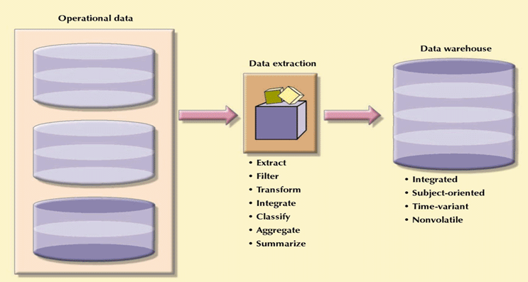
Creating a Data Warehouse
CH#2, Data Warehousing
By: Babu Ram Dawadi

Slide 16
Factors Common to Data Warehousing
Dynamic framework for decision support that is always a work in progress
Must satisfy:
  Data integration and loading criteria
  Data analysis capabilities with acceptable query performance
  End-user data analysis needs
Apply database design procedures
CH#2, Data Warehousing
By: Babu Ram Dawadi

Slide 17
Why Separate Data Warehouse?
High performance for both systems
  DBMS— tuned for OLTP: access methods, indexing, concurrency control, recovery
  Warehouse—tuned for OLAP: complex OLAP queries, multidimensional view, consolidation(aggregation).
Different functions and different data:
  missing data: Decision support requires historical data which operational DBs do not typically maintain
  data consolidation: Decision Support requires consolidation (aggregation, summarization) of data from heterogeneous sources
  data quality: different sources typically use inconsistent data representations, codes and formats

Slide 18
Decision Support Systems
Methodology (or series of methodologies) designed to extract information from data and to use such information as a basis for decision making
Decision support system (DSS):
  Arrangement of computerized tools used to assist managerial decision making within a business
  Usually requires extensive data “massaging” to produce information
  Used at all levels within an organization
  Often tailored to focus on specific business areas
  Provides ad hoc query tools to retrieve data and to display data in different formats
CH#2, Data Warehousing
By: Babu Ram Dawadi

Slide 19
Decision Support Systems (continued)
Composed of four main components:
  Data store component
    Basically a DSS database
  Data extraction and filtering component
    Used to extract and validate data taken from operational database and external data sources
  End-user query tool
    Used to create queries that access database
  End-user presentation tool
    Used to organize and present data
CH#2, Data Warehousing
By: Babu Ram Dawadi

Slide 20
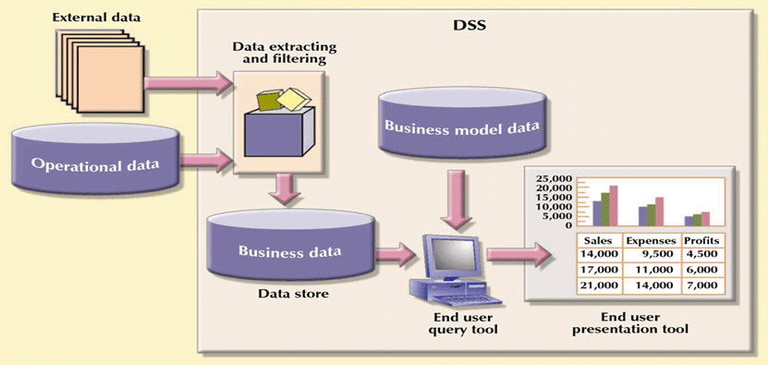
Main Components of a
Decision Support System (DSS)
CH#2, Data Warehousing
By: Babu Ram Dawadi

Slide 21
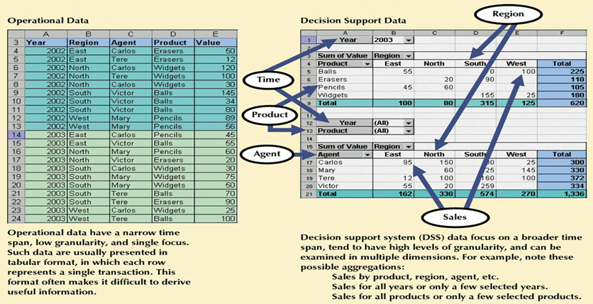
Transforming Operational Data Into Decision Support Data
CH#2, Data Warehousing
By: Babu Ram Dawadi

Slide 22
Designing DSS
DSS is the more general term referring to all kinds of analysis of existing data in order to make better decisions, like: data mining, OLAP, Simulation etc…
DSS design differs considerably from that of an online transaction processing (OLTP). In contrast to OLTP, DSS are used only for queries.
CH#2, Data Warehousing
By: Babu Ram Dawadi

Slide 23
Designing DSS
Designing a DSS seeks particular importance on:
  Requirement of the end user
  Software requirement
  Hardware requirement
End user requirement
  Discuss with the end user
  People who need to use DSS produce a huge variety of queries
  Some are interested only on a particular part of the information so that they may prefer to optimize the application completely in order to speed up the query process.
CH#2, Data Warehousing
By: Babu Ram Dawadi

Slide 24
DSS …
Software Requirement
  Type of software depends very much on the requirement of the end user.
  Working on a client/server environment allows flexibility in choosing the appropriate software for end users.
  For data mining, software can be split into two parts:
    The first works with the algorithms on the database server
    The second work on the local workstation.
CH#2, Data Warehousing
By: Babu Ram Dawadi

Slide 25
DSS…
Hardware Requirement
  A large DW can contain hundreds of thousands of giga bytes.
    So DW is designed by Engineer with knowledge of both hardware and software
  For data mining, it is not always necessary to have a very large database and a large database server.
CH#2, Data Warehousing
By: Babu Ram Dawadi
Notes:
Data Warehousing

Slide 26
ON-LINE ANALYTICAL PROCESSING (OLAP)
CH#2, Data Warehousing
By: Babu Ram Dawadi

Slide 27
OLAP
WHAT IS OLAP?
DEFINITION :
‘OLAP applications and tools are those that are designed to ask ad hoc, complex queries of large multidimensional collections of data. It is for this reason that OLAP is often mentioned in the context of Data Warehouses’.
CH#2, Data Warehousing
By: Babu Ram Dawadi
Notes:
Data Warehousing

Slide 28
The Multidimensional Idea
Region
Sales
Granularity
Year
Product
category
Quarter
Product
type
Product
3 dimensions

Slide 29
OLAP
MULTDIMENSIONAL DATA MODEL
London
Glasgow
Socks
Newcastle
Jumpers
10 50 10 10
T-Shirts
0 0 1 2
Shorts
80 80 80 80
Pyjamas
0
25 20 15
0 0 0 0
Spring Summer Autumn Winter
Example: Three dimensions – Product, Sales, Area, and Season
CH#2, Data Warehousing
By: Babu Ram Dawadi

Slide 30
Storage: The Cube
Region
Mobiles Fax Standard
Vaud
Fribourg
Neuchatel
1999
Product
type
1998
1997
Year
Sales of standard telephones
in 1997 in Vaud region

Slide 31
OLAP Terminology
A data cube supports viewing/modelling of a variable (a set of variables) of interest. Measures are used to report the values of the particular variable with respect to a given set of dimensions.
A fact table stores measures as well as keys representing relationships to various dimensions.
Dimensions are perspectives with respect to which an organization wants to keep record.
A star schema defines a fact table and its associated dimensions.

Slide 32
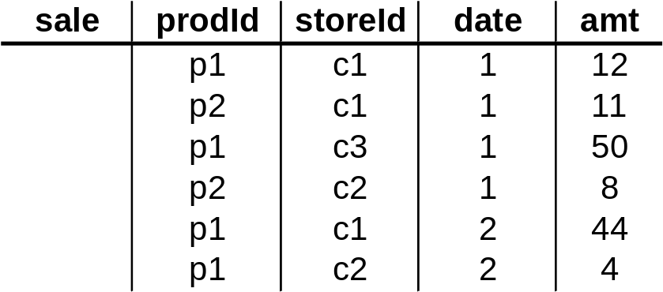
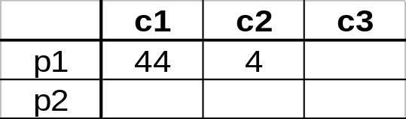
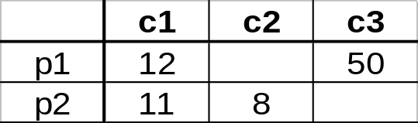
3-D Cube
Fact table view:
Multi-dimensional cube:
day 2
day 1
dimensions = 3
CH#2, Data Warehousing
By: Babu Ram Dawadi

Slide 33
Typical OLAP Operations
Roll up (drill-up): summarize data
  by climbing up hierarchy or by dimension reduction
Drill down (roll down): reverse of roll-up
  from higher level summary to lower level summary or detailed data, or introducing new dimensions
Slice and dice:
  project and select
Pivot (rotate):
  reorient the cube, visualization, 3D to series of 2D planes.
Other operations
  drill across: involving (across) more than one fact table
Han: Dataware Houses and OLAP

Slide 34
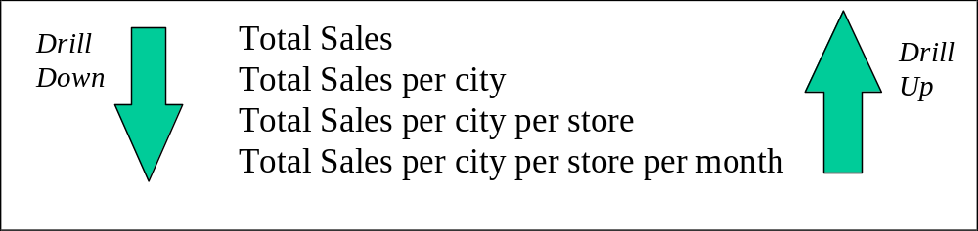
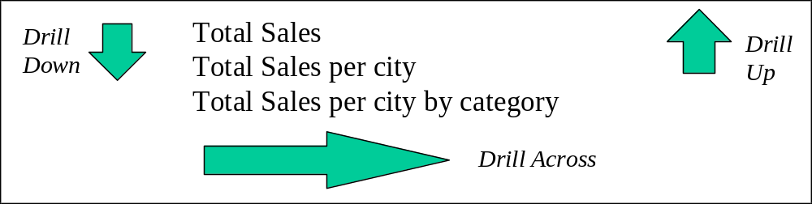
OLAP
TYPICAL OLAP OPERATIONS
CH#2, Data Warehousing
By: Babu Ram Dawadi

Slide 35
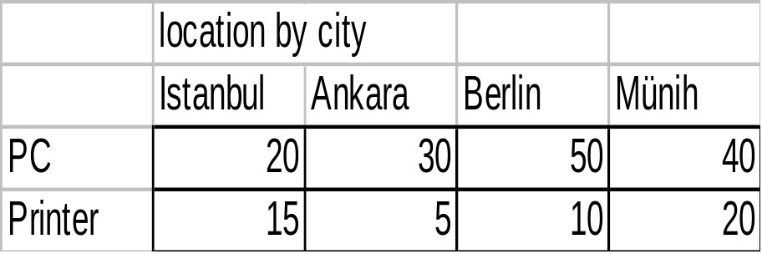
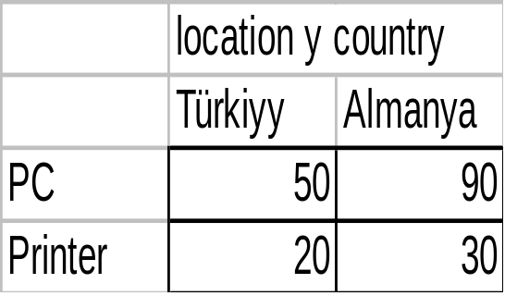
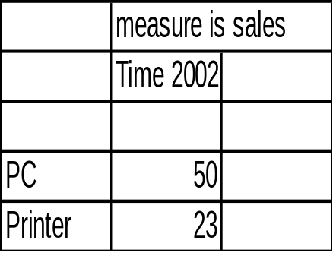
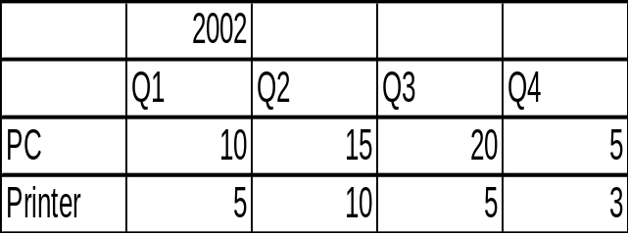
By a drill up opperation examine sales
By country rather than city level
roll up
Drill down
CH#2, Data Warehousing
By: Babu Ram Dawadi

Slide 36
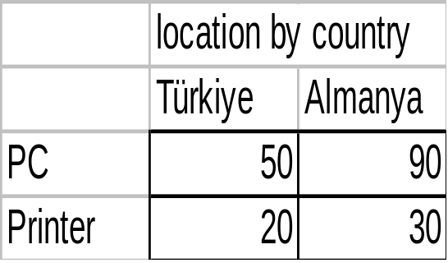
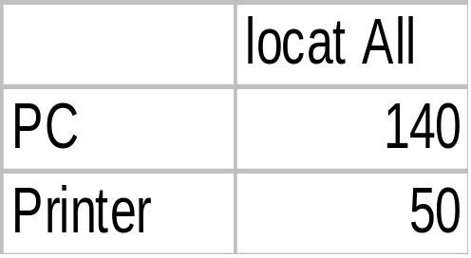
when performed by dimension reduction
  one or more dimensions are removed from the cube
Ex a sales cube with location and time
  roll-up may remove the time dimension
  aggregation of total sales by location
    rather than by location and by time
Two dimensional cuboid
One dim. cuboid

Slide 37
Roll-up and Drill-down algebraic operators
3
28
25
9
44
1997
180
244
72
35
180
244
72
9
51
42
318
204
78
5
27
1998
22
318
204
78
8
11
3
35
Lausane
}Vaud
131
153
57
11
Vevey
131
153
57
46
Vaud
1999
Brig
}Valais
Valais
Sion
mobiles
fax
standard
mobiles
fax
standard
TOWN
Roll-up
REGION
Less detailed: go up in the granularity hierarchy
Drill-down
More detailed: go down in the granularity hierarchy

Slide 38
Slice and dice
Slice: a selection on one dimension of the cube resulting in subcube
Ex: sales data are selected for dimension time using time =spring
dice: defines a subcube by performing a selection on two or more dimensions
Ex: a dice opp. Based on
  location=“london” or “glasgow” and
  time =spring or summer and
  item = “T-shirts” or “Pyjamas”
CH#2, Data Warehousing
By: Babu Ram Dawadi

Slide 39
N-DİMENSİONAL CUBE
A data cube is referred to as a cuboid
The lattice of cuboids forms a data cube.
The cuboid holding the lowest level of summarization is called a base cuboid.
  the 4-D cuboid is the base cuboid for the given four dimensions
The top most 0-D cuboid, which holds the highest-level of summarization, is called the apex cuboid.
  typically denoted by all

Slide 40
Cube: A Lattice of Cuboids
all
0-D(apex) cuboid
time
item
location
supplier
1-D cuboids
time,item
time,location
item,location
location,supplier
2-D cuboids
time,supplier
item,supplier
time,item,location
time,location,supplier
3-D cuboids
time,item,supplier
item,location,supplier
4-D(base) cuboid
time, item, location, supplier

Slide 41
CONCEPTUAL MODELING OF DATA WAREHOUSES
Modeling data warehouses: dimensions & measures
  Star schema: A fact table in the middle connected to a set of dimension tables
  Snowflake schema: A refinement of star schema where some dimensional hierarchy is normalized into a set of smaller dimension tables, forming a shape similar to snowflake
  Fact constellation: Multiple fact tables share dimension tables, viewed as a collection of stars, therefore called galaxy schema or fact constellation

Slide 42
EXAMPLE OF STAR SCHEMA
time
time_key
day
day_of_the_week
month
quarter
year
item
item_key
item_name
brand
type
supplier_type
Sales Fact Table
time_key
item_key
branch_key
branch
location
location_key
branch_key
branch_name
branch_type
location_key
street
city
province_or_street
country
units_sold
dollars_sold
avg_sales
Measures

Slide 43
DEFINING A STAR SCHEMA IN DMQL
Cube Definition (Fact Table)
  define cube <cube_name> [<dimension_list>]: <measure_list>
Dimension Definition ( Dimension Table )
  define dimension <dimension_name> as (<attribute_or_subdimension_list>)
define cube sales_star [time, item, branch, location]:
    dollars_sold = sum(sales_in_dollars), avg_sales = avg(sales_in_dollars), units_sold = count(*)
define dimension time as (time_key, day, day_of_week, month, quarter, year)
define dimension item as (item_key, item_name, brand, type, supplier_type)
define dimension branch as (branch_key, branch_name, branch_type)
define dimension location as (location_key, street, city, province_or_state, country)

Slide 44
EXAMPLE OF SNOWFLAKE SCHEMA
time
item
time_key
day
day_of_the_week
month
quarter
year
item_key
item_name
brand
type
supplier_key
supplier
Sales Fact Table
supplier_key
supplier_type
time_key
item_key
branch_key
branch
location
location_key
location_key
street
city_key
branch_key
branch_name
branch_type
units_sold
city
dollars_sold
city_key
city
province_or_street
country
avg_sales
Measures

Slide 45
EXAMPLE OF FACT CONSTELLATION
time
time_key
day
day_of_the_week
month
quarter
year
item
Shipping Fact Table
item_key
item_name
brand
type
supplier_type
Sales Fact Table
time_key
time_key
item_key
shipper_key
item_key
branch_key
from_location
branch
location_key
location
to_location
branch_key
branch_name
branch_type
units_sold
location_key
street
city
province_or_street
country
dollars_cost
dollars_sold
units_shipped
avg_sales
shipper
Measures
shipper_key
shipper_name
location_key
shipper_type

Slide 46
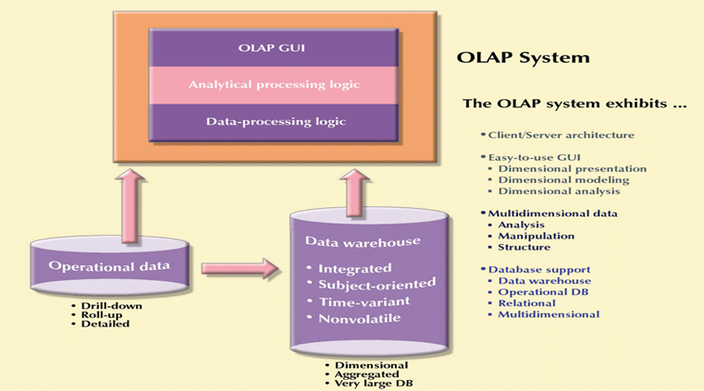
OLAP CLIENT/SERVER ARCHITECTURE
CH#2, Data Warehousing
By: Babu Ram Dawadi

Slide 47
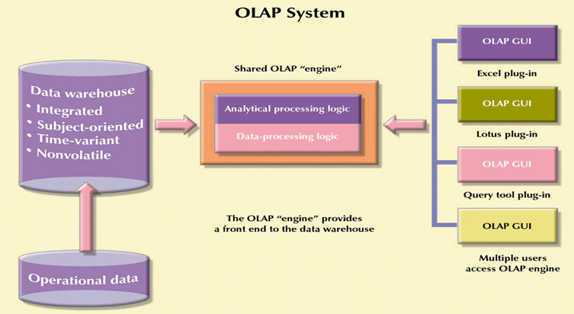
OLAP SERVER ARRANGEMENT
CH#2, Data Warehousing
By: Babu Ram Dawadi

Slide 48

OLTP VS. OLAP

Slide 49
OLTP –VS- OLAP
On Line Transaction Processing -- OLTP
  Maintain a database that is an accurate model of some real-world enterprise
    Short simple transactions
    Relatively frequent updates
    Transactions access only a small fraction of the database
On Line Analytic Processing -- OLAP
  Use information in database to guide strategic decisions
    Complex queries
    Infrequent updates (Load)
    Transactions access a large fraction of the database

Slide 50
Business Information:
“How you gather, manage,
and use information
will determine whether
you win or lose.”
– Bill Gates
CH#2, Data Warehousing
By: Babu Ram Dawadi

Slide 51
What is BI?
Business Intelligence means using your data assets to make better business decisions.
Business intelligence involves the gathering, management, and analysis of data for the purpose of turning that data into useful information which is then used to improve decision making.
Organizations can then make more strategic decisions about how to administer clients and programs. These practices can also reduce operating costs through more effective financial analysis, risk management, and fraud management.
CH#2, Data Warehousing
By: Babu Ram Dawadi

Slide 52
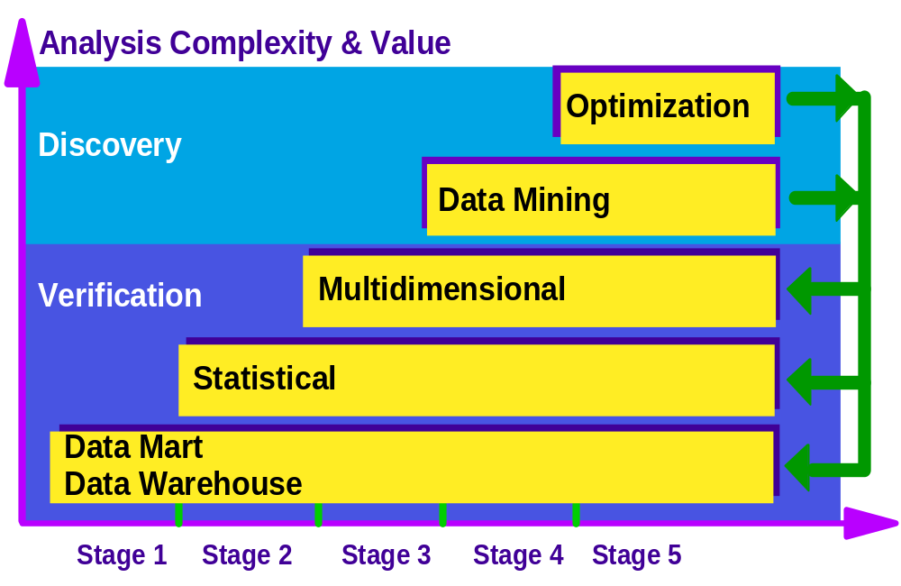
Business Intelligence solutions start with data warehouses and data marts
CH#2, Data Warehousing
By: Babu Ram Dawadi

Slide 53
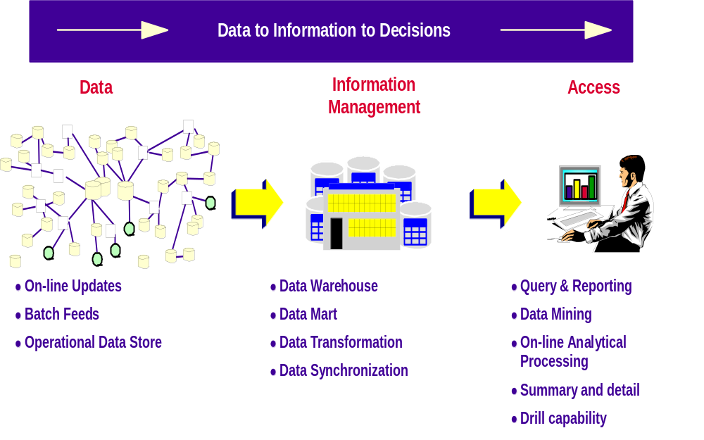
Data… Information….Decisions
CH#2, Data Warehousing
By: Babu Ram Dawadi

Slide 54
Knowledge discovery in databases
KDD is the process of identifying valid,potentially useful and understandable patterns & relationships in data
 Knowledge = patterns & relationships
knowledge discovery =
data preparation + data mining + evaluation/interpretation of discovered patterns/relationships
Nowadays,  KDD = data mining
CH#2, Data Warehousing
By: Babu Ram Dawadi

Slide 55
Knowledge Discovery in Database Environment (Stages)
There are six stages of KDD which are:
  Data selection
  Cleaning
  Enrichment
  Coding
  Data mining
  reporting
CH#2, Data Warehousing
By: Babu Ram Dawadi

Slide 56
Data Mining: A KDD Process
Pattern Evaluation
Knowledge
  Data mining: the core of knowledge discovery process.
Data Mining
Task-relevant Data
Data Warehouse
Selection
Data Cleaning
Data Integration
CH#2, Data Warehousing
Databases
By: Babu Ram Dawadi
Notes:
Data Warehousing

Slide 57
KDD : Data selection
Data Selection
  It is the first stage of KDD process in which we collect and select the data set or database required to work with
  Data sets are obtained from operational databases
  Obtaining information from centralized databases can be difficult, reasons may be:
    Data set may need conversion from one format to another
      Eg: Excel files to access files
CH#2, Data Warehousing
By: Babu Ram Dawadi

Slide 58
KDD: Data selection
  Different quality of data in different parts are available
  Making choice on right data is important
  Investigations should be made on any data warehouses available in an organization.
  A well maintained DW helps to make data selection job convenient by providing right data set necessary for analysis.
Data Cleaning
  This is the second stage of KDD.
  Data set obtained is never perfectly cleaned.
  We may not be aware of to what extent it is polluted.
CH#2, Data Warehousing
By: Babu Ram Dawadi

Slide 59
KDD: Data selection
  Data in real world is dirty:
    Incomplete: lack attribute values
    Noisy: contains errors
      Human errors
      Not available when collected
      Not entered due to misunderstanding
      Malfunction of hardware/software
      Mistake data entry
    Inconsistent: contains discrepancies codes
  The cleaning phenomena should try to eliminate all the above mentioned defects by the stage of de-duplication, domain consistency, disambiguation
CH#2, Data Warehousing
By: Babu Ram Dawadi

Slide 60
KDD …
Enrichment
  Enrichment is the process of adding additional information to the databases or accessing additional databases to obtain extra information.
  Eg: an airline company might cooperate with telephone company to enhance its marketing policy. A telephone company maintains large databases comprising the call behavior of customers & create telephone profiles of the basis of these data.
CH#2, Data Warehousing
By: Babu Ram Dawadi

Slide 61
KDD …
  These telephone profiles could be used by airlines to identify interesting new groups of target customers
  So data miners can collect all the necessary information from additional bought – in databases.
  Obtaining information from other organizations may involve some tedious procedures.
Coding:
  Coding is one of the most important stage where further cleaning and transformation of data is done.
CH#2, Data Warehousing
By: Babu Ram Dawadi

Slide 62
KDD …
Coding…
  It can range from simple SQL Queries to using sophisticated high level languages depending upon requirement.
  Some polluted records can be easily filtered out by using SQL queries. (Eg: Records with most of the field empty can be easily traced and removed)
  Coding is the creative activity which involves creative transformation of data.
  It can be used to obtained more simpler form of the complete, detailed database.
CH#2, Data Warehousing
By: Babu Ram Dawadi

Slide 63
KDD: Coding
Coding…
  Example: to the table of the magazine publisher, we can apply following coding steps:
    Convert address to region (area codes)
    Birth date to age
    Divide income by 1000
    Divide credit by 1000
    Convert owners yes/no to 1/0
    Convert purchase date to month starting from 1990
    Perform filtering
CH#2, Data Warehousing
By: Babu Ram Dawadi

Slide 64
KDD: Coding
Coding: applying steps 1 to 6
Client No | Age | income | Credit | Car owner | H. Woner | Region | Month of purchase | Mag. purchased
203 | 20 | 18.5 | 17.8 | 0 | 0 | 1 | 52 | Car
203 | 20 | 18.5 | 17.8 | 0 | 0 | 1 | 42 | Music
209 | 25 | 36.0 | 26.6 | 1 | 0 | 1 | Null | Comic
203 | 20 | 18.5 | 17.8 | 0 | 0 | 1 | 48 | house
CH#2, Data Warehousing
By: Babu Ram Dawadi

Slide 65
KDD: Coding
Coding: applying step 7
Client NO | Age | Income | Credit | Car owner | House owner | Region | Car. Mag. | House Mag. | Sport Mag. | Music Mag. | Comic Mag.
203 | 20 | 18.5 | 17.8 | 0 | 0 | 1 | 1 | 1 | 0 | 1 | 0
209 | 25 | 36.0 | 26.6 | 1 | 0 | 1 | 0 | 0 | 0 | 0 | 1
CH#2, Data Warehousing
By: Babu Ram Dawadi

Slide 66
KDD: DataMining
Data Mining:
  All the cleanings, transformations and enrichment are performed on data, so that we can extract the most useful information from it, and this is performed in data mining stage of KDD.
  It consists of different rules, techniques, and algorithms used for mining purpose.
  These are involved in performing following three tasks:
    Knowledge Engineering Tasks
    Classification tasks
    Problem solving tasks
CH#2, Data Warehousing
By: Babu Ram Dawadi

Slide 67




KDD: DM
Knowledge Engineering Tasks
DM…
Inductive Logic
Programming
Different Algorithms Concerned with Different Tasks
*Association Rules
K- nearest neighbor
Decision Trees
Genetic Algorithms
Classification Tasks
Problem Solving Tasks
CH#2, Data Warehousing
By: Babu Ram Dawadi

Slide 68
KDD: Data mining
Knowledge engineering:
  is the process of finding right formal representation of certain body of knowledge in order to represent it in a knowledge based system
    Eg: Expert Systems (medical diagnostic system)
Classification tasks:
  Classification is the process of dividing data into no. of classes. Eg: class of customers
Problem Solving Tasks:
  It involves finding solutions of remedies to the problems that arise. Eg: why are people not going to cinema hall?
CH#2, Data Warehousing
By: Babu Ram Dawadi

Slide 69
KDD…
For finding useful patterns in databases, it is necessary to choose right algorithms and right tools.
For choosing right data mining algorithms following three points should be considered:
  Quality of input [No. of records, attributes, numeric]
  Quality of output [yes/no results, statistics]
  Performance [CPU load]
CH#2, Data Warehousing
By: Babu Ram Dawadi

Slide 70
KDD: Reporting
This stage involves documenting the results obtained from learning algorithms.
Any report writer or graphical tools can be used
It basically combines two functions:
  Analysis of results obtained from mining.
  Application of results to new data
Different data visualization tools like scatter diagrams available for showing different patterns or clusters of data can be used.
CH#2, Data Warehousing
By: Babu Ram Dawadi

